Slide 1
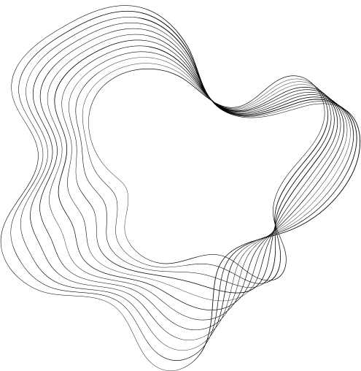
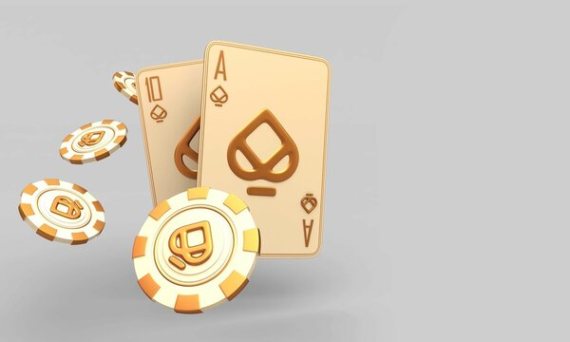
BLACKJACK PROJECT PROPOSAL

Slide 2
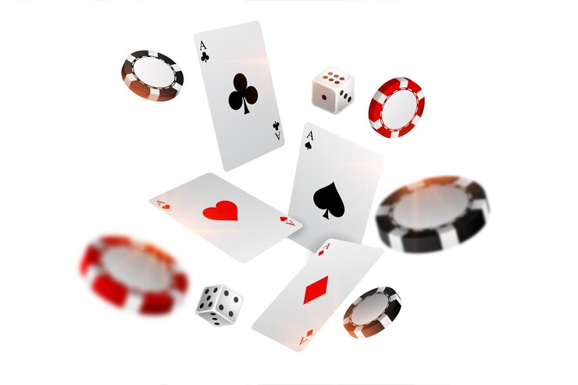
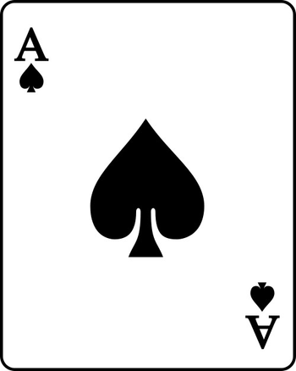
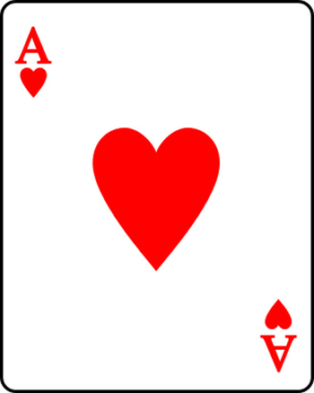
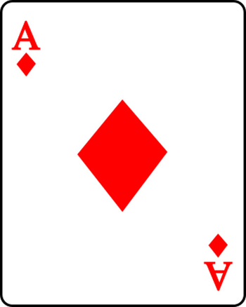
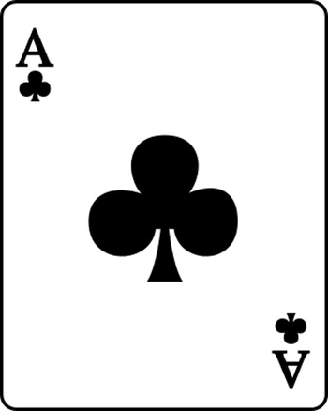

MEMBERS
Đỗ Thành Đạt
ITDSIU21079
Ngô Hoàng Thành
ITDSIU21119
Nguyễn Bá Duy
ITDSIU21014
Phạm Huỳnh Thanh Quân
ITDSIU21110

Slide 3

CONTENT
1
INTRODUCTION
2
RULES
3
CLASS DIAGRAM
4
DEMO
5
LIMITS AND FEATURE
6
CONCLUSION

Slide 4
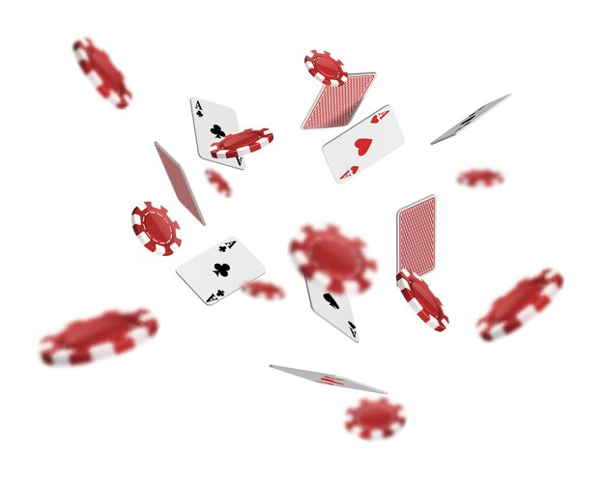
INTRODUCTION

Slide 5

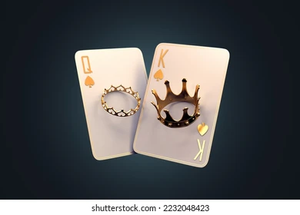
This project was designed based on Object – Oriented Programming method in Java language. So this has solved some problems that occurred while building by a common Procedural – Oriented Method:
The project is a unified logic system with many related - Classes combined together
Each Class has many Methods which take on different behaviors of their own class. The ability to reuse resources

Slide 6
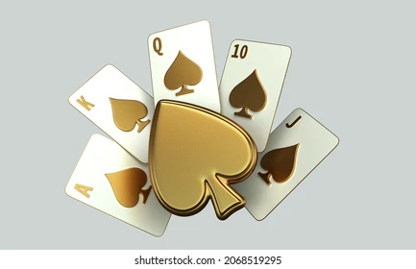
RULES

Slide 7


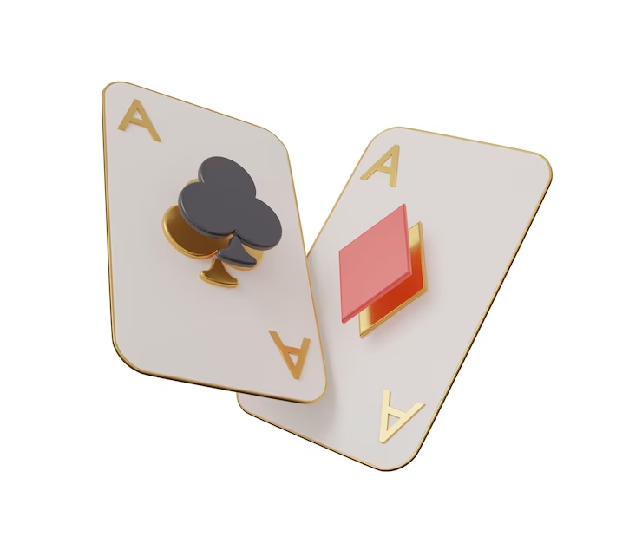

1. GOAL: have a hand value closer to 21 than the dealer's hand without exceeding 21.
2. CARD VALUES:
- Face cards (King, Queen, Jack) are each worth 10 points.
- Aces can be worth either 1 or 11 points, depending on which value benefits the hand more

Slide 8



RULES
3. THE DEAL:
You are dealt two cards each, and the dealer receives one card face up and one face down (hole card).
4. TURN:
You can choose to "hit" (take another card) or "stand" (keep your current hand).
You can continue to hit until you decide to stand, or until your hand exceeds 21, resulting in a bust.
.

Slide 9

5. WINNING & LOSING
-You win if your hand is closer to 21 than the dealer's hand without busting.
-If you bust (exceeds 21), the dealer wins regardless of the dealer's hand.
-If the dealer busts, you win.
-If both the player (you) and dealer have the same hand value, it's a push (a tie), and your bet is returned.

Slide 10
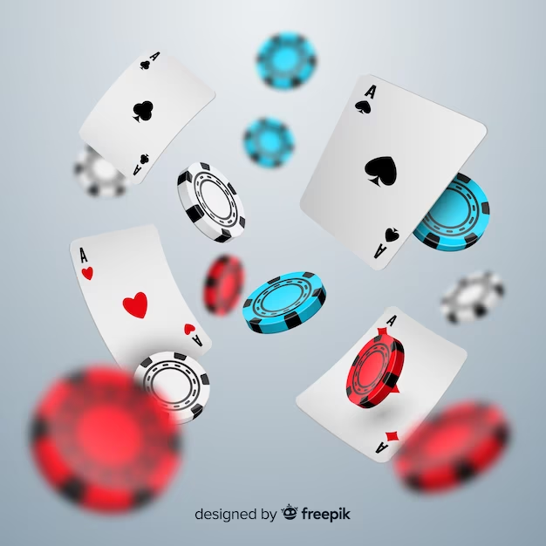
CLASS DIAGRAM

Slide 11
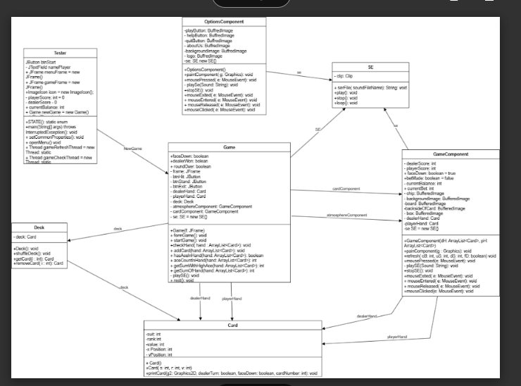

Slide 12
https://drive.google.com/file/d/1MzeUgUj9GLihWNnLQtkQN1aSIjUvXdpw/view?usp=drive_link

Slide 13

DEMO

Slide 14

LIMITS AND FEATURES

Slide 15

PROBLEM
Create a CardShop where you can spend money to acquire new card decks or backgrounds.
Players can save games.
Change the decks such that, unlike most casinos, eight complete decks of cards are used in a game.

Slide 16

CONCLUSION

Slide 17


CONCLUSION
The Blackjack game is constructed using object-oriented programming, providing a transparent demonstration of OOP principles such as polymorphism, inheritance, encapsulation, and abstraction.

Slide 18
CONCLUSION
The tight and systematic linkage between classes and objects is evident, showcasing the effective application of OOP concepts.

Slide 19
CONCLUSION
Additionally, undertaking this project offers the valuable opportunity to extend our learning beyond the course boundaries, acquiring knowledge that goes beyond the predefined curriculum. This expansion of knowledge is recognized as a crucial aspect of our project implementation.

Slide 20
THANK YOU
FOR LISTENING

Slide 21

REFERENCES
REFERENCES 1
https://www.youtube.com/watch?v=Kmgo00avvEw&t=3368s
REFERENCES 2
https://www.youtube.com/watch?v=hJ3OGZ8cIRI&list=PLGxHvpw-PAk5ydWA2c-jCMBcoraHgTgxn
REFERENCES 3
https://www.youtube.com/watch?v=buGFs1aQgaY

Slide 22
REFERENCES
REFERENCES 4
https://www.ryisnow.online/2021/05/java-sample-code-black-jack-game.html
REFERENCES 5
https://www.ryisnow.online/2021/04/java-for-beginner-how-to-play-audio.html
REFERENCES 6
https://www.ryisnow.online/2021/04/java-code-sample-scrolling-text-like.html

